Slide 1
Advanced Java Programming B.Sc.CSIT Seventh Semester
By Narayan Subedi

Slide 2
Unit 2: User Interface Components with Swing

Slide 3
2.1 Swing and MVC Design Patterns
Swing
Swing is a GUI widget toolkit for Java.
It is part of Oracle's Java Foundation Classes (JFC) — an API for providing a graphical user interface (GUI) for Java programs.
FC consists of the Abstract Window Toolkit (AWT), Swing and Java 2D.
Swing is currently in the process of being replaced by JavaFX.

Slide 4
Design Patterns
A design pattern in architecture and computer science is a formal way of documenting a solution to a design problem in a particular field of expertise.
The idea was introduced by the architect Christopher Alexander in the field of architecture and has been adapted for various other disciplines, including computer science.
MVC Pattern
Singleton Pattern
Factory Pattern
http://www.tutorialspoint.com/design_pattern/
Notes:
Design patterns are solutions to general problems that software developers faced during software development.

Slide 5
MVC Pattern
MVC Pattern is a software architectural pattern for implementing user interfaces.
It divides a given software application into three interconnected parts, i.e. Model, View and Controller.
The Model, which stores the content
The View, which displays the content
The Controller, which handles user input

Slide 6
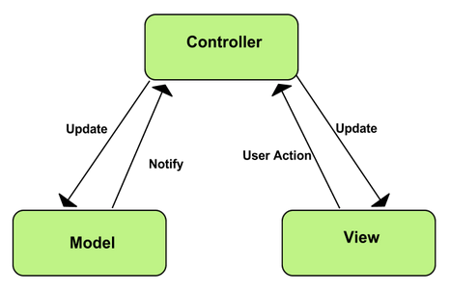
MVC Pattern

Slide 7
MVC Analysis of Swing Buttons
Swing Buttons use MVC Pattern internally
DefaultButtonModel implements ButtonModel which can define the state of the various kinds of buttons. Model provides information like whether the button is Enabled, is Pressed …
JButton button = new JButton("Blue"); ButtonModel model = button.getModel();
model.isEnabled();
The JButton uses a class called BasicButtonUI for the view and a class called ButtonUIListener as controller.

Slide 8
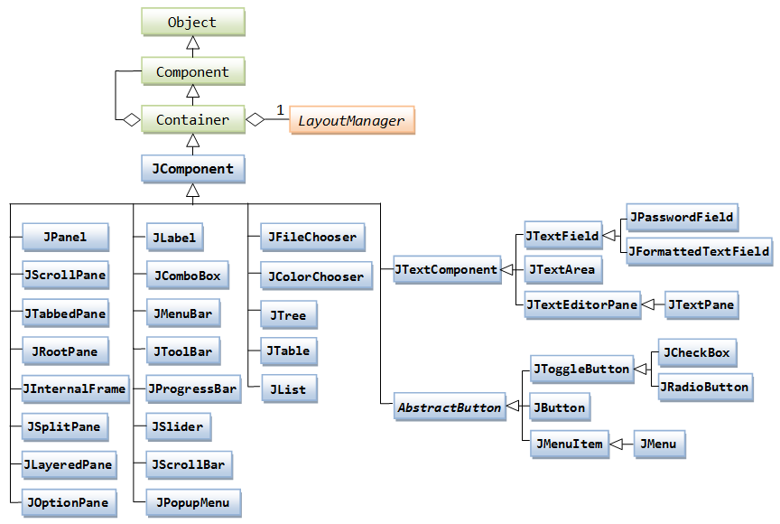
Swing Container Hierarchy

Slide 9
2.2 Layout Management
Layout Manager
A layout manager is an object that implements the LayoutManager interface and determines the size and position of the components within a container.
Setting the Layout Manager
Using the JPanel constructor. For example:
JPanel panel = new JPanel(new BorderLayout());
Using setLayout method. For example:
Container contentPane = frame.getContentPane(); contentPane.setLayout(new FlowLayout());

Slide 10
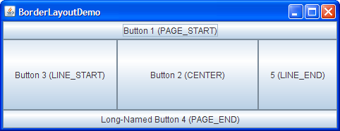
Layout Management
Border Layout
A BorderLayout places components in up to five areas: top, bottom, left, right, and center.
All extra space is placed in the center area.
BorderLayout(int horizontalGap, int verticalGap)

Slide 11
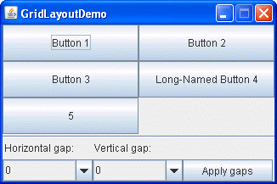
Layout Management
Grid Layout
GridLayout simply makes a bunch of components equal in size and displays them in the requested number of rows and columns.
GridLayout(int rows, int cols)
GridLayout(int rows, int cols, int hgap, int vgap)

Slide 12
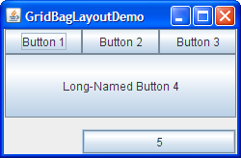
Layout Management
Gridbag Layout
GridBagLayout is a sophisticated, flexible layout manager.
It aligns components by placing them within a grid of cells, allowing components to span more than one cell.
The rows in the grid can have different heights, and grid columns can have different widths.

Slide 13
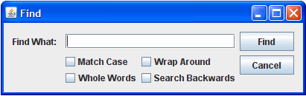
Layout Management
Group Layout
GroupLayout works with the horizontal and vertical layouts separately.
The layout is defined for each dimension independently.
Consequently, however, each component needs to be defined twice in the layout.
http://docs.oracle.com/javase/tutorial/uiswing/layout/groupExample.html

Slide 14
Layout Management
Using No Layout Manager
There will be times when you don’t want to bother with layout managers but just want to drop a component at a fixed location (sometimes called absolute positioning).
1. Set the layout manager to null.
2. Add the component you want to the container.
3. Specify the position and size that you want:
frame.setLayout(null); JButton ok = new JButton("OK"); frame.add(ok); ok.setBounds(10, 10, 30, 15);
void setBounds(int x, int y, int width, int height)
moves and resizes a component.

Slide 15
Layout Management
Custom layout Managers
Every layout manager must implement at least the following five methods, which are required by the LayoutManager interface:
void addLayoutComponent(String s, Component c);
void removeLayoutComponent(Component c);
Dimension preferredLayoutSize(Container parent);
Dimension minimumLayoutSize(Container parent);
void layoutContainer(Container parent);

Slide 16
Layout Management
void addLayoutComponent(String, Component) Called by the Container class's add methods. Layout managers that do not associate strings with their components generally do nothing in this method.
void removeLayoutComponent(Component) Called by the Container methods remove and removeAll. Layout managers override this method to clear an internal state they may have associated with the Component.
Dimension preferredLayoutSize(Container) Called by the Container class's getPreferredSize method, which is itself called under a variety of circumstances. This method should calculate and return the ideal size of the container, assuming that the components it contains will be at or above their preferred sizes. This method must take into account the container's internal borders, which are returned by the getInsets method.
Dimension minimumLayoutSize(Container) Called by the Container getMinimumSize method, which is itself called under a variety of circumstances. This method should calculate and return the minimum size of the container, assuming that the components it contains will be at or above their minimum sizes. This method must take into account the container's internal borders, which are returned by the getInsets method.
void layoutContainer(Container) Called to position and size each of the components in the container. A layout manager's layoutContainer method does not actually draw components. It simply invokes one or more of each component's setSize, setLocation, and setBounds methods to set the component's size and position.

Slide 17
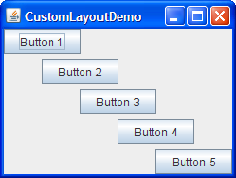
Layout Management
http://docs.oracle.com/javase/tutorial/uiswing/layout/custom.html

Slide 18
2.3 Text Input

Slide 19
2.4 Choice Components:

Slide 20
2.5 Menus:
A menu bar at the top of a window contains the names of the pull-down menus. Clicking on a name opens the menu containing menu items and submenus.

Slide 21
2.5 Menus:
Keyboard Mnemonics
JMenuItem aboutItem = new JMenuItem("About", 'A');
JMenu helpMenu = new JMenu("Help"); helpMenu.setMnemonic('H');
Accelerators
Use the setAccelerator method to attach an accelerator key to a menu item.
The setAccelerator method takes an object of type Keystroke.
openItem.setAccelerator(KeyStroke.getKeyStroke("ctrl O"));

Slide 22
2.5 Menus:
Enabling and Disabling Menu Items
To enable or disable a menu item, use the setEnabled method:
saveItem.setEnabled(false);

Slide 23
2.5 Menus:
Toolbars
A toolbar is a button bar that gives quick access to the most commonly used commands in a program.
What makes toolbars special is that you can move them elsewhere.
JToolBar bar = new JToolBar(); bar.add(blueButton);
Tooltips
Tooltip is a info label displayed over a button when mouse hover’s in it.
blueButton.setToolTipText("Blue Button");

Slide 24
2.6 Dialog Boxes:
Modal dialog box
A modal dialog box won’t let users interact with the remaining windows of the application until he or she deals with it. Eg. a file dialog box
Modeless dialog box
A modeless dialog box lets the user enter information in both the dialog box and the remainder of the application. Eg. a toolbar.

Slide 25

2.6 Dialog Boxes:
Option Dialogs
The JOptionPane has four static methods to show dialogs:
JOptionPane.showMessageDialog(null, "alert", "alert", JOptionPane.ERROR_MESSAGE);
http://docs.oracle.com/javase/7/docs/api/javax/swing/JOptionPane.html

Slide 26
2.6 Dialog Boxes:
Creating Dialogs
In your new dialogbox class extend JDialog class
In the constructor of your dialog box, call the constructor of the superclass JDialog.
Add the user interface components of the dialog box.
Add the event handlers.
Set the size for the dialog box.
When you call the superclass constructor, you will need to supply the owner frame, the title of the dialog, and the modality.
The owner frame controls where the dialog is displayed.
The modality specifies which other windows of your application are blocked while the dialog is displayed

Slide 27
2.6 Dialog Boxes:
Creating Dialog Example

Slide 28
2.6 Dialog Boxes:
Data Exchange Example

Slide 29
2.6 Dialog Boxes:
File Choosers
Swing provides a JFileChooser class that allows you to display a file dialog box.
showOpenDialog to display a dialog for opening a file
showSaveDialog to display a dialog for saving a file
The button for accepting a file is then automatically labeled Open or Save.
You can also supply your own button label with the showDialog method.

Slide 30
2.6 Dialog Boxes:
File Choosers Steps
Make a JFileChooser object. For example: JFileChooser chooser = new JFileChooser();
Set the directory by calling the setCurrentDirectory method.For example, to use the current working directory chooser.setCurrentDirectory(new File("."));
If you have a default file name that you expect the user to choose: chooser.setSelectedFile(new File(filename));
Show the dialog box by calling : int result = chooser.showOpenDialog(parent); int result = chooser.showSaveDialog(parent); You can also call the showDialog method and pass an explicit text for the approve button: int result = chooser.showDialog(parent, "Select");

Slide 31
2.6 Dialog Boxes:
File Choosers Example:

Slide 32
2.6 Dialog Boxes:
Color Choosers:
Except JFileChooser class, Swing provides only one additional chooser, the JColorChooser.
Use it to let users pick a color value.
Color selectedColor = JColorChooser.showDialog(parent, title, initialColor);

Slide 33
2.7 Components Organizers
Split Panes
JSplitPane is used to divide two (and only two) Components.
The two Components are graphically divided based on the look and feel implementation, and the two Components can then be interactively resized by the user.
JSplitPane splitPane = new JSplitPane(JSplitPane.VERTICAL_SPLIT, panel1, panel2);
frame.getContentPane().add(splitPane);

Slide 34
2.7 Components Organizers
Tabbed Panes
With the JTabbedPane class, you can have several components, such as panels, share the same space.
The user chooses which component to view by selecting the tab corresponding to the desired component.
If you want similar functionality without the tab interface, you can use a CardLayout instead of a tabbed pane.

Slide 35
2.7 Components Organizers
Desktop Panes and Internal Frames
A container used to create a multiple-document interface or a virtual desktop.
You create JInternalFrame objects and add them to the JDesktopPane.
A JInternalFrame is confined to a visible area of a container it is placed in.

Slide 36
2.7 Components Organizers
Cascading and Tiling
The Java JDesktopPane and JInternalFrame classes have no built-in support for these operations.
To cascade all the JInternalFrame follow the following :
1) Get a collection of all the JInternalFrame from the JDesktopPane
JInternalFrame[] frames = desktopPane.getAllFrames();
for each of the frame, shift the location of each by 10 pixels right and 30 pixels left to show the cascading effect. 30 pixels is because the height of the title is about the same.
int x = 10; int y = 10; for(int i=0 ; i frames.length; i++){ frames.setLocation(x,y); x+=10; y+=30; }
2) for tiling, you got to find out how many rows and columns the desktop pane can hold. Then set the location of each such that each occupies its cell.

Slide 37
2.8 Advance Swing Components
List
The JList component shows a number of items inside a single box.
As of Java SE 7, JList is a generic type.
The type parameter is the type of the values the user can select. In this example, we use a JList<String>.
String[] words= { "quick", "brown", "hungry", "wild", . . . }; JList<String> wordList = new JList<>(words);

Slide 38
2.8 Advance Swing Components
Trees
The JTree class (together with its helper classes) takes care of laying out the tree and processing user requests for expanding and collapsing nodes.
TreeModel model = . . .; JTree tree = new JTree(model);

Slide 39
2.8 Advance Swing Components
Tables
The JTable component displays a two-dimensional grid of objects.
Object[][] cells = { { "Mercury", 2440.0, 0, false, Color.YELLOW }, { "Venus", 6052.0, 0, false, Color.YELLOW }, . . . }
String[] columnNames = { "Planet", "Radius", "Moons", "Gaseous", "Color" };
JTable table = new JTable(cells, columnNames);

Slide 40
2.8 Advance Swing Components
Progress Bars
JProgressBar is a Swing component that indicates progress.
A ProgressMonitor is a dialog box that contains a progress bar.
A ProgressMonitorInputStream displays a progress monitor dialog box while the stream is read.
progressBar = new JProgressBar(0, 1000); progressBar = new JProgressBar(SwingConstants.VERTICAL, 0, 1000);
progressBar.setValue(chunk); // sets the value of progress bar
// below line computes the completion percentage
progressBar.setStringPainted(true);

Slide 41
Questions ???

